Slide 1
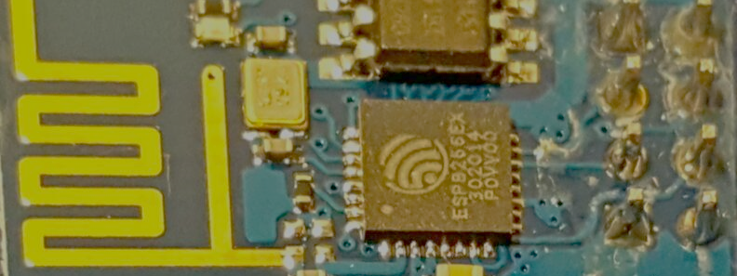
Getting started with ESP8266 and IOT
From a beginner Hobbyist to a beginner Hobbyist.
Ahmed Maklad

Slide 2
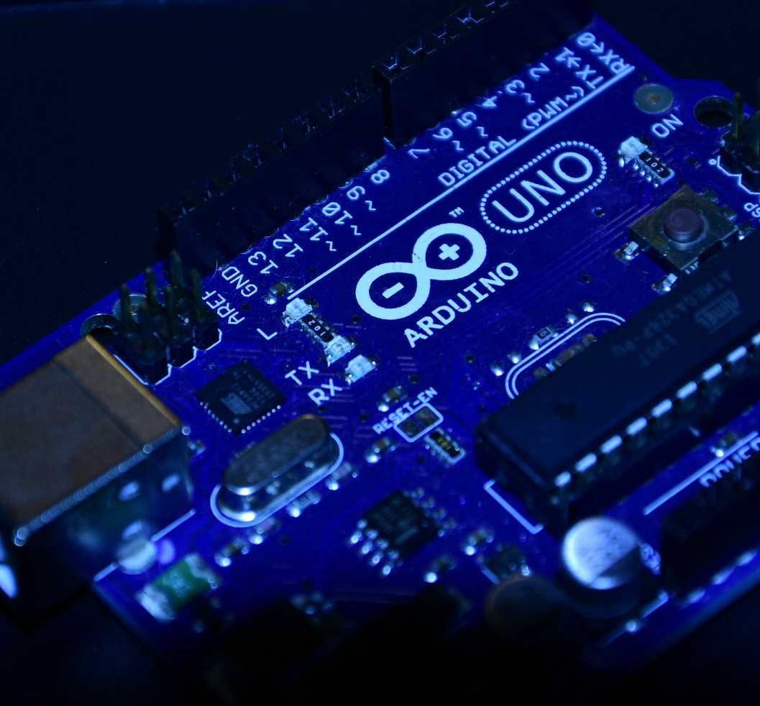
A Peek into IOT
Just a short introduction

Slide 3
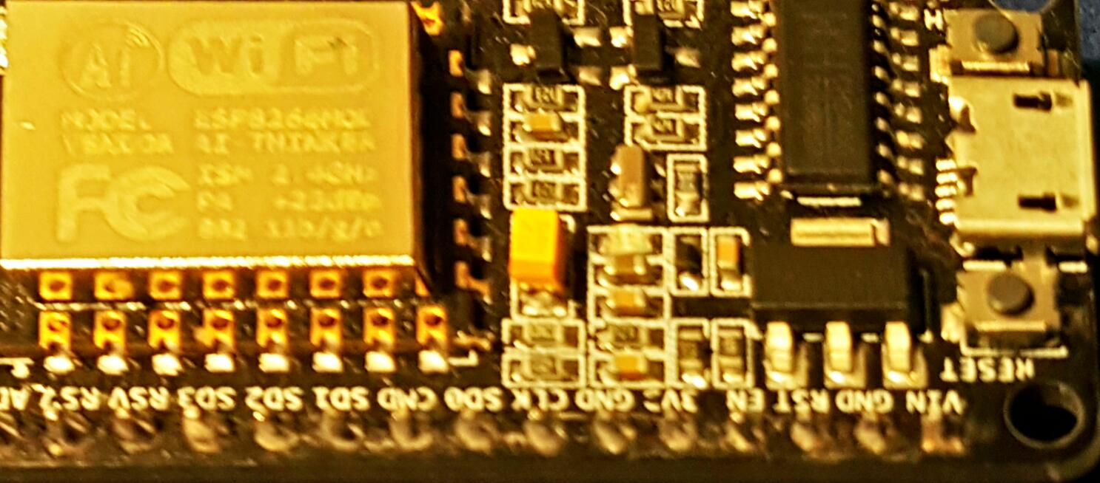
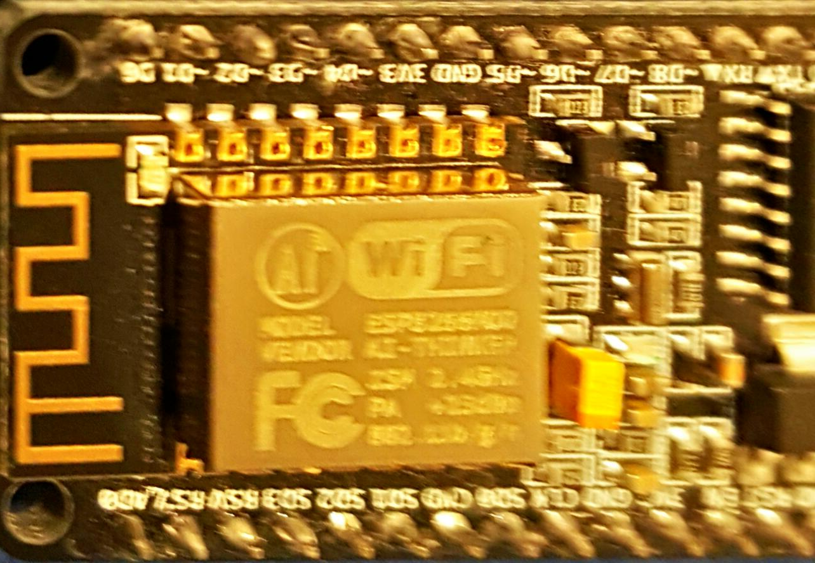
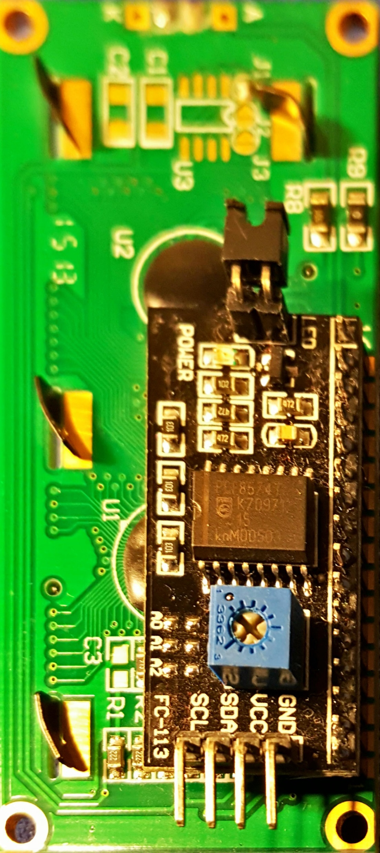
The World 2050
70 % of world population would live in the Cities.
Crowded Cities = Scale problems
Scale Problems = need for more Automation
More Automation = need more readings/input from the environment
More readings = More Data to Transfer
More readings = More Data to Process
More Processing= more Actuators to feedback into the environment.

Slide 4
IOT Elements
The combination of these elements creates IOT as we know it:
Sensors and Actuators
Connectivity
People and Resources

Slide 5
IOT
Internet of Things
Things network/communicate through protocols Wifi, LOARAWAN, BLT , RF 2.4 GHz ,NFC ...etc
Machine-Human
Machine-Machine M2M
Society 4.0
Industry 4.0
4th Industrial Revolution (Steam –Electric- Electronic- IOT)

Slide 6
Eclipse Three stacks Model of IOT
https://iot.eclipse.org/resources/white-papers/Eclipse%20IoT%20White%20Paper%20-%20The%20Three%20Software%20Stacks%20Required%20for%20IoT%20Architectures.pdf
Constrained Device
  MCU / CPU
  Sensors
  Focused devices
  Limited Memory, Processing, communication ..etc
  OS /RTOS
Gateway
  Aggregation of Sensors.
  OS
  Data management
  Messaging
IOT Cloud Platform
  Data Management (DB)
  Event management / Analytics
  Security /device Registry
  UI

Slide 7
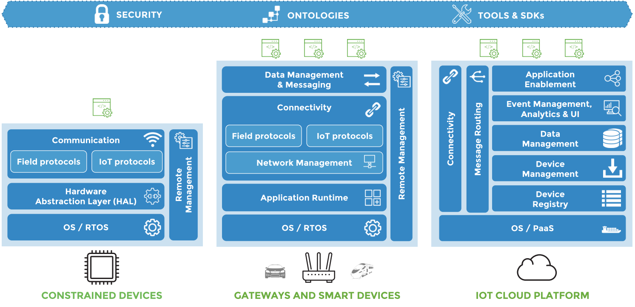
Eclipse Three stacks of IOT

Slide 8
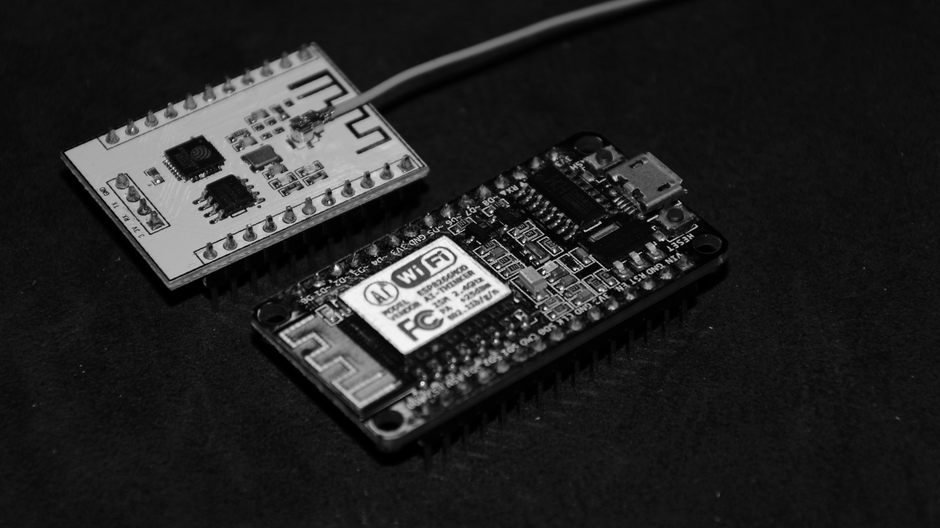
Why do we need the Cloud with IOT ?
Heavy Lifting Processing
  Image Processing
  Speech Recognition
  Knowledge database (example: FarmBot.org).
  Machine Learning
  Prediction , projection.
  Large JSON/XML/Response parsing and reduction
More Connectivity channels (M-M , M-H) like email, SMS, twitter, facebook, Encryption, app-notification ..etc
Distributed (example: Car approaching, house automation, Garage door ..etc)
ML and Data Analysis

Slide 9

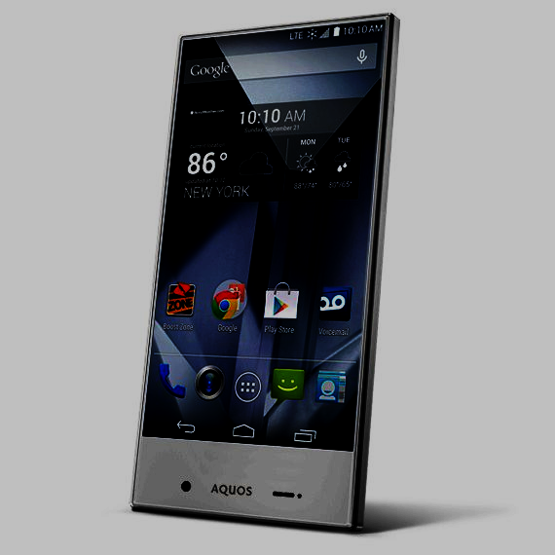
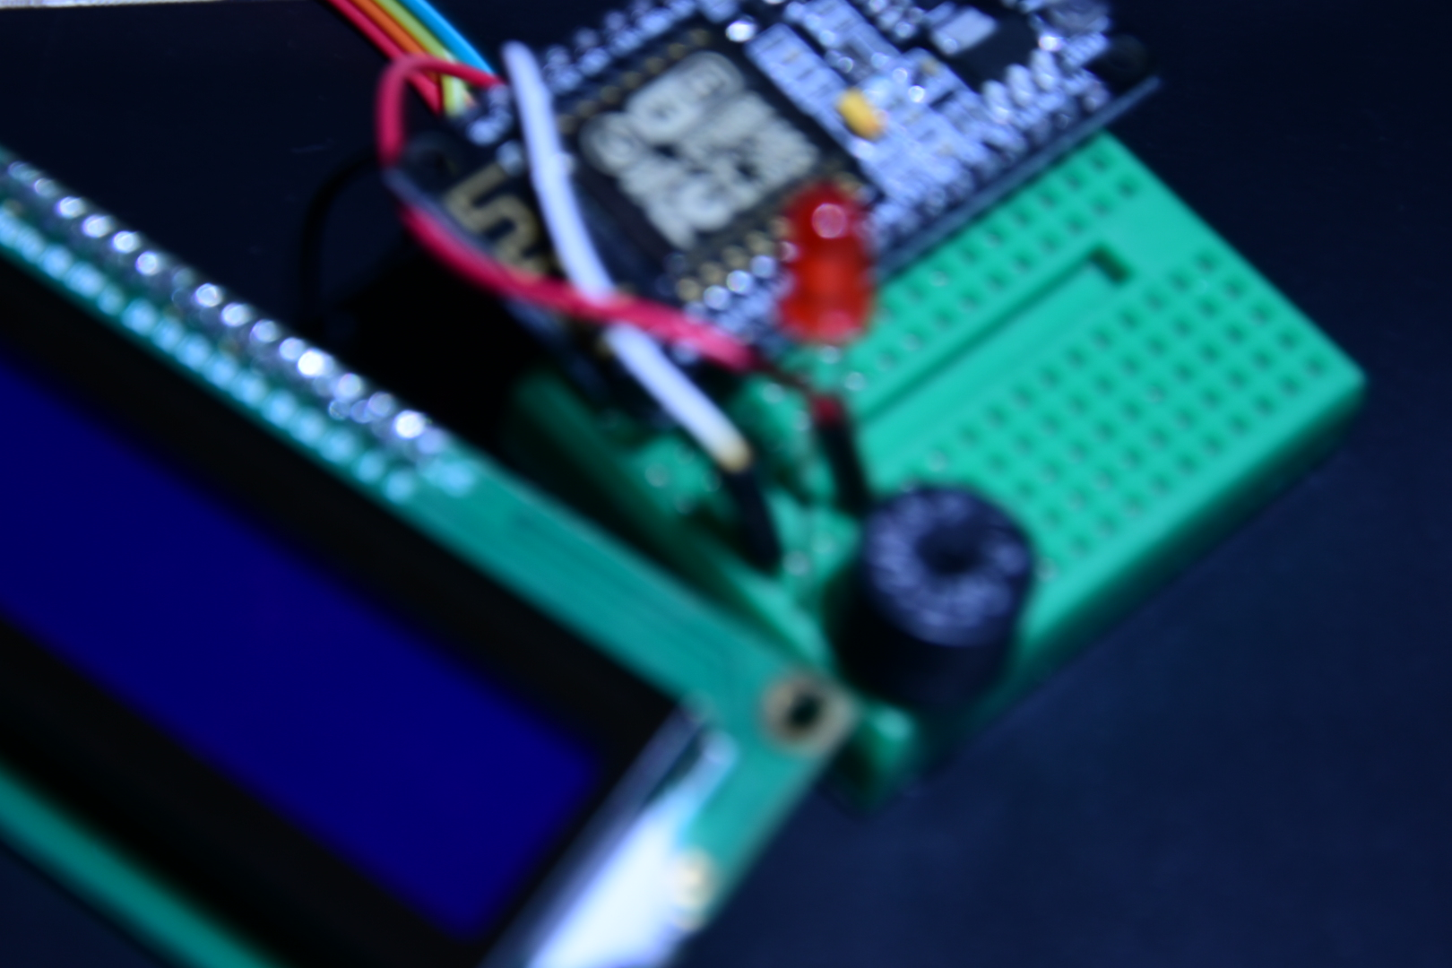
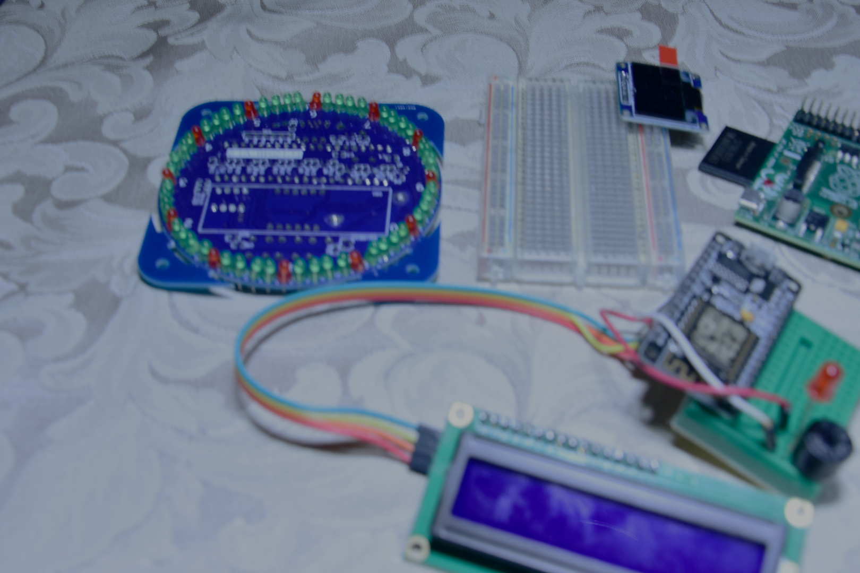

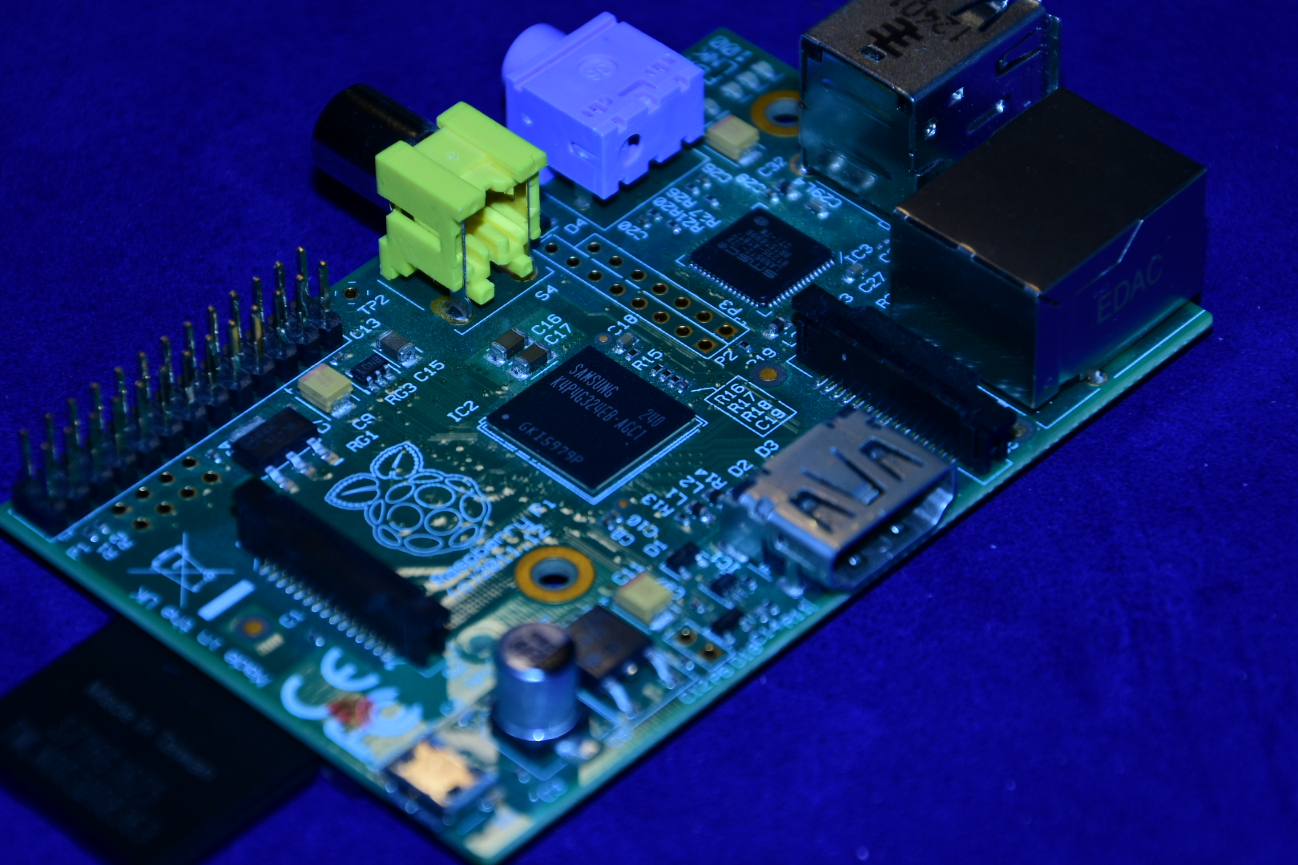
Example IOT Scenario:
192.168.1.101/digital/6
192.168.1.101/digital/6/1
RESTful call (aRest Library)
Sensor
#include <aREST.h>
Subscribe
Router
Thingspeak.com
#include <PubSubClient.h>
SWI
TCH
mosquitto.org
aRest.io
MQTT
ifttt.com
publish
temboo.com
dweet.io
cloud.arduino.cc
(Digitalocean.com)
www.openhab.org
RPI, CHIP, VoCore , Commercial Products, …etc

Slide 10
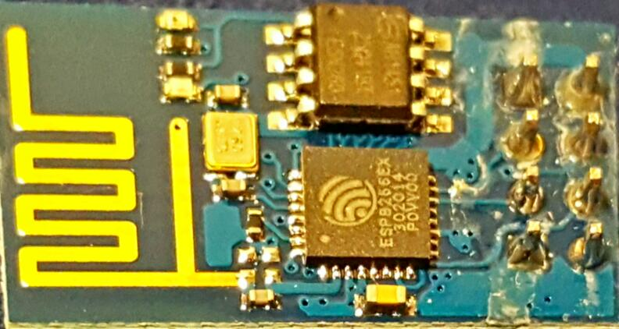
A typical ESP8266 project/product:
ESP_WebConfig Framework/ starting point. https://github.com/thunderace/ESP_WebConfig
Internet
HTML
JSON/XML
2)Connect as a station
Router
/Switch
NTP
REST
Join the ESP-AP and
configure the WIFI credentials
Config
Web
Pages
1)Starts as an AP

Slide 11

Other WIFI options
ESP8285 / ESP8255
ESP32
Realtek RTL8710
VoCore
Arduino Yun
Chip

Slide 12
https://github.com/asmaklad/ESP8266-Dojo

